Slide 1
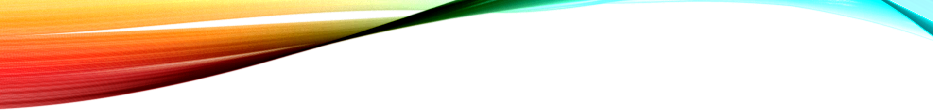
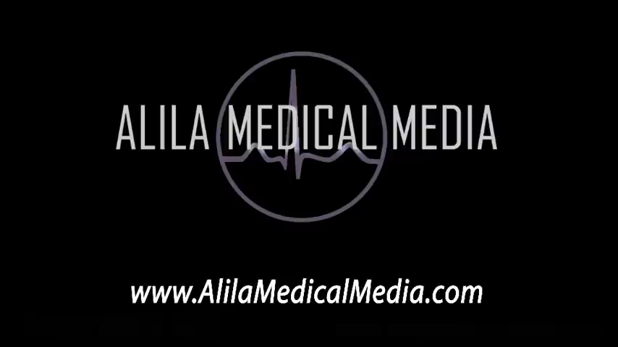
The Pathway of Blood Flow Through the Heart
https://www.youtube.com/watch?v=BEWjOCVEN7M

Slide 2
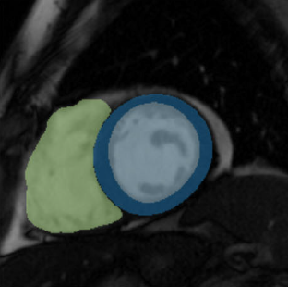
Some keywords in this context:
What is cardiac magnetic resonance (CMR):
A type of MRI specifically focused on the heart.
Uses magnetic fields and radio waves to create detailed images of the heart and its blood vessels.
What are "Blood pool" and "myocardium“ regions:
The blood-pool refers to the interior cavity of a ventricle (or atrium) where the blood is flowing.
The myocardium is the muscular wall surrounding that cavity.
Myocardial blood flow (MBF):
How much blood actually reaches that muscle through the coronary arteries.
Arterial input function (AIF):
The concentration of the Gadolinium that is being delivered to the muscle over time
Picture got from: Geomtry_paper

Slide 3
The problem to measure blood flow in heart and vessels:
How to estimate blood flow in the heart muscle:
By injecting a material called gadolinium into the bloodstream, and then by taking a sequence of MRI images
What is the problem:
MRI signal is not directly proportional to gadolinium concentration
The MRI scanner measures signal intensity,
Not the actual concentration of gadolinium
The relationship between these two is not perfectly linear
This is a big problem for quantitative analysis
Solution:
Must use a robust mathematical models, like the Fermi function deconvolution

Slide 4
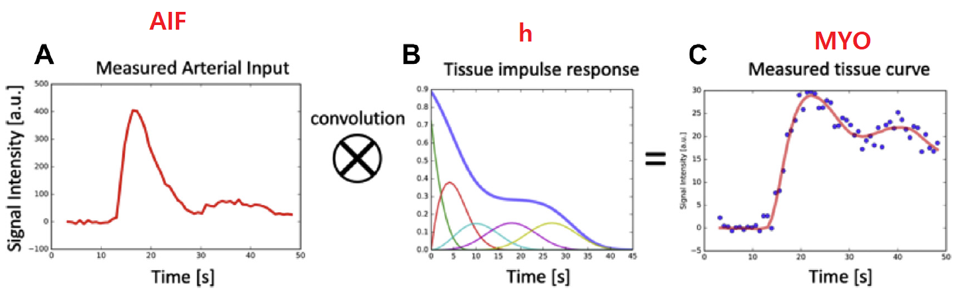
How myocardial blood flow (MBF) is calculated:
There are two main modeling approaches:
a) Tracer-kinetic (blood-tissue exchange) model
b) Deconvolution approach
It assumes that the tissue signal curve is the convolution of the input (AIF) with the tissue impulse response
By deconvolving the tissue curve with the AIF, we recover that impulse response.
The height (amplitude) of this impulse response at time zero represents the blood flow through that tissue.
Deconvolution is unstable mathematically (for example by using Fourier Transform obtained negative values)
A constrain such as Fermi function is used, which provides a physiologically realistic shape for the response curve.

Slide 5
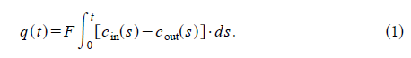
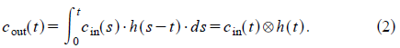
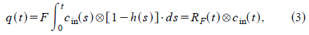
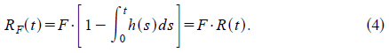
Approximating the tissue impulse response with a Fermi function:
The amount of tracer in the ROI at any time, q(t), is simply the difference between the amount of tracer that was washed in and washed out.
F is the rate of flow
R(t) represents the probability that a tracer molecule remains in the ROI up to time t.
The shape of the tissue impulse response, R(t), can be approximated with a Fermi function.

Slide 6
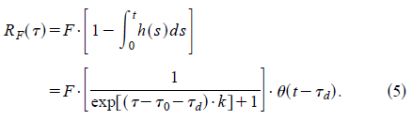
Approximating the tissue impulse response with a Fermi function:
The analytical expression for the Fermi function model is:

Slide 7
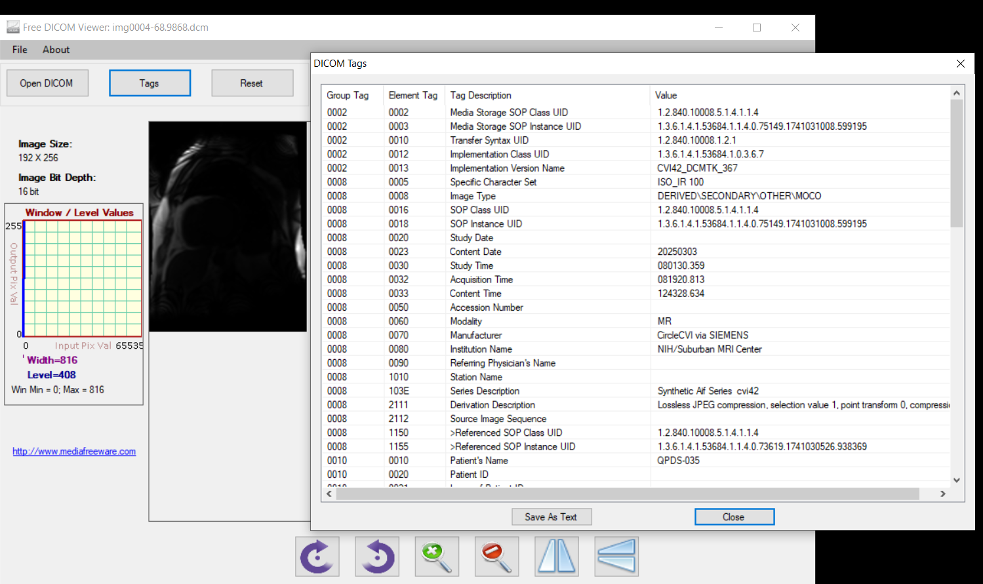
What is the content of the DICOM files

Slide 8
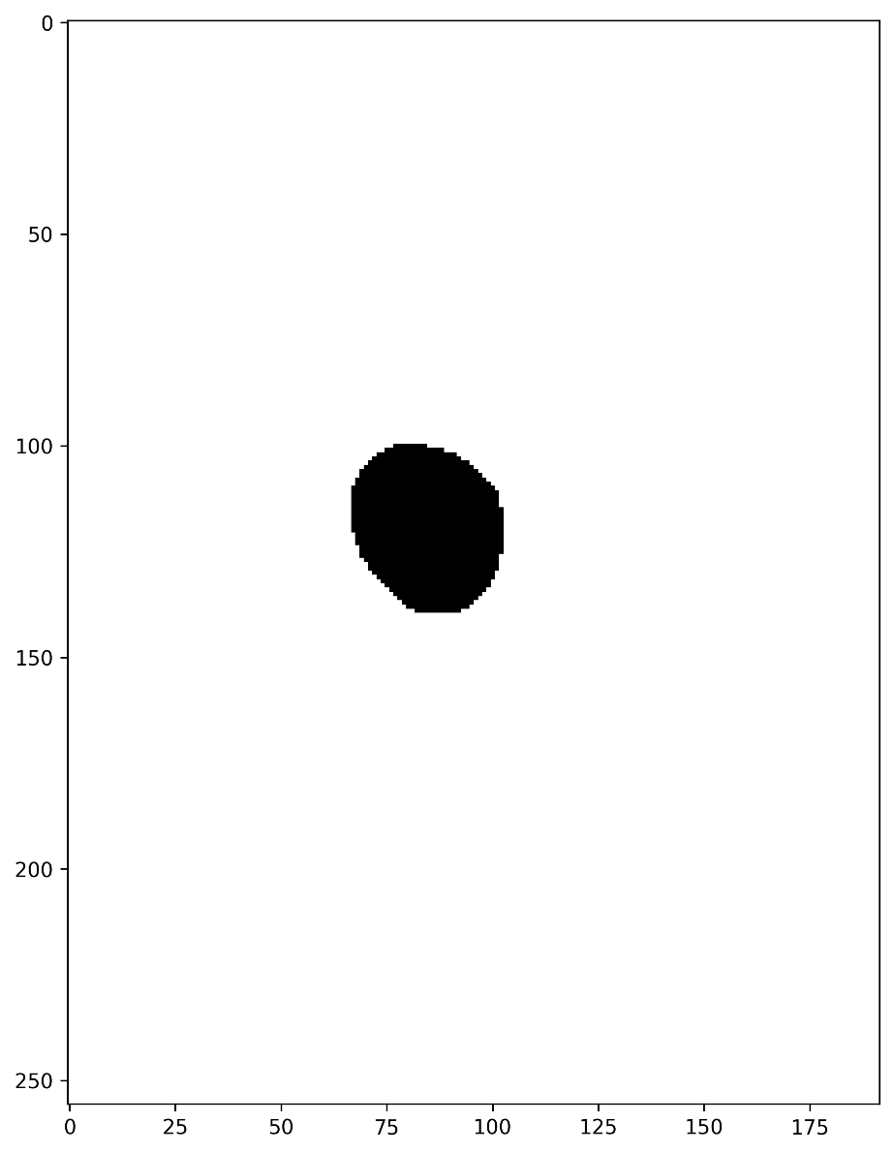
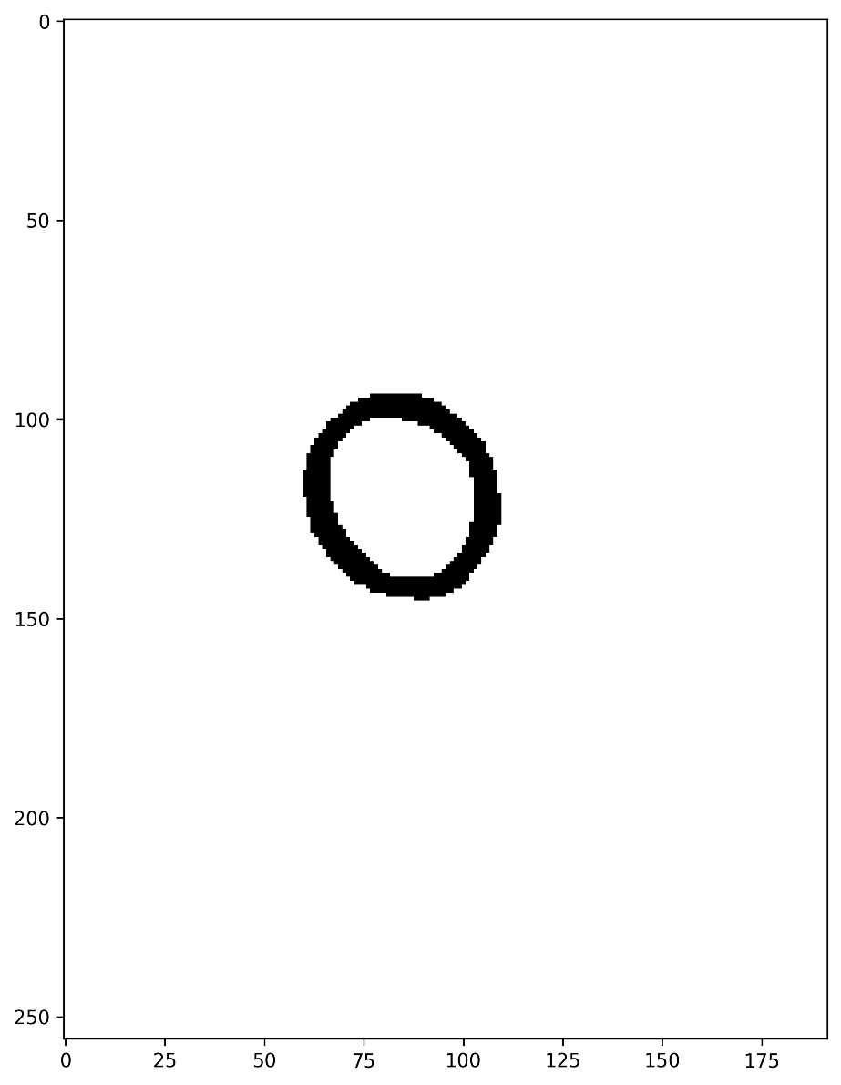
What is the two regions in the tiff file
The “AIF_And_Myo_Masks.tiff” file
Blood pool region are pixels that mask==0
Myocardium region are pixels that mask==1

Slide 9
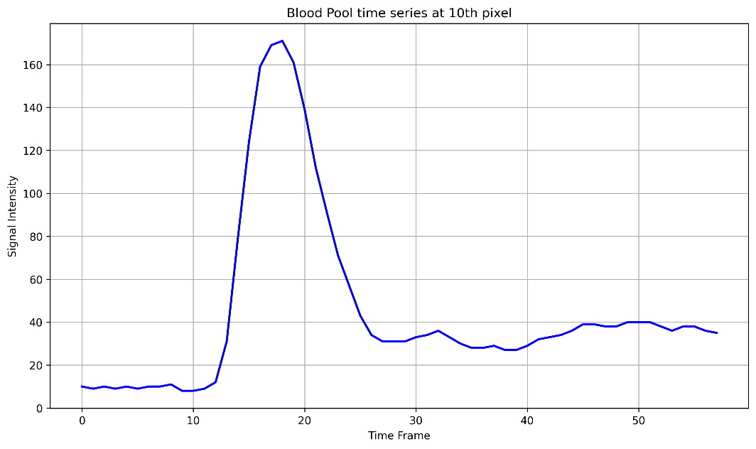
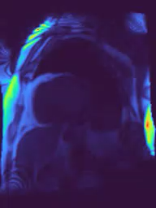
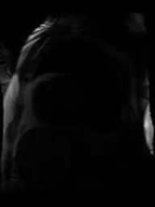
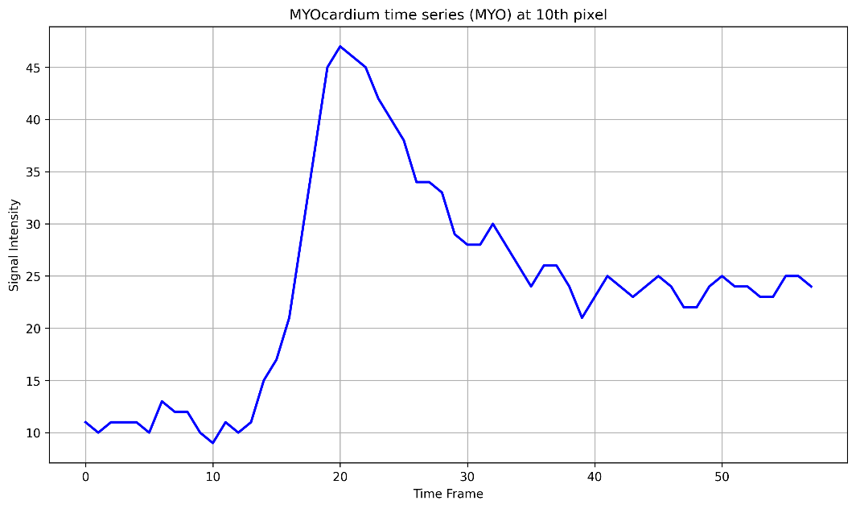
The content of the DICOM files over time
The signal intensity at a pixel of Blood pool region.
The signal intensity at a pixel of myocardium region.
Blood flow through the heart, animation.

Slide 10
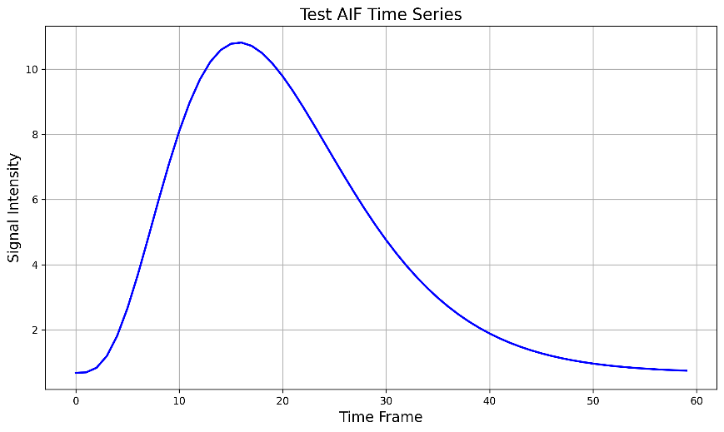
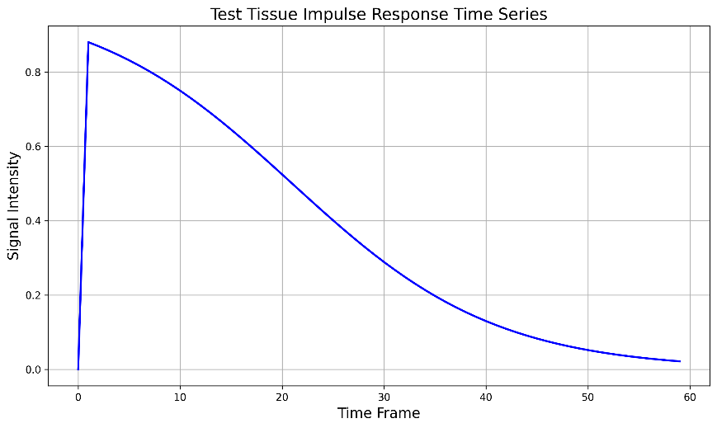
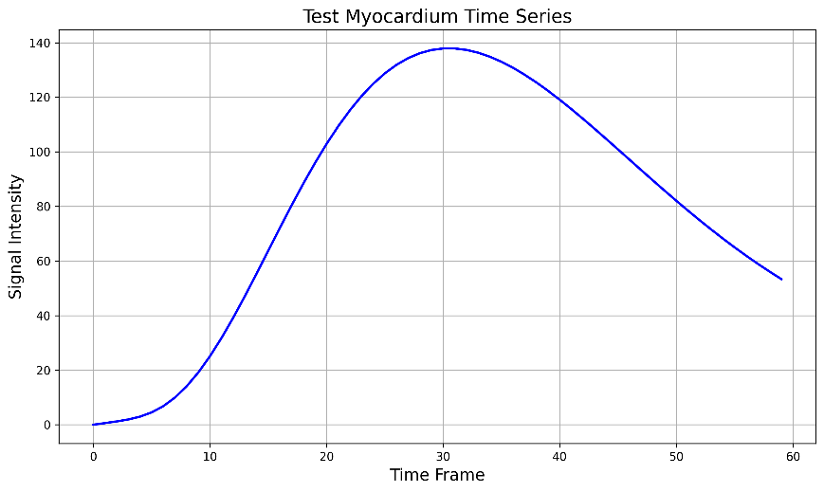
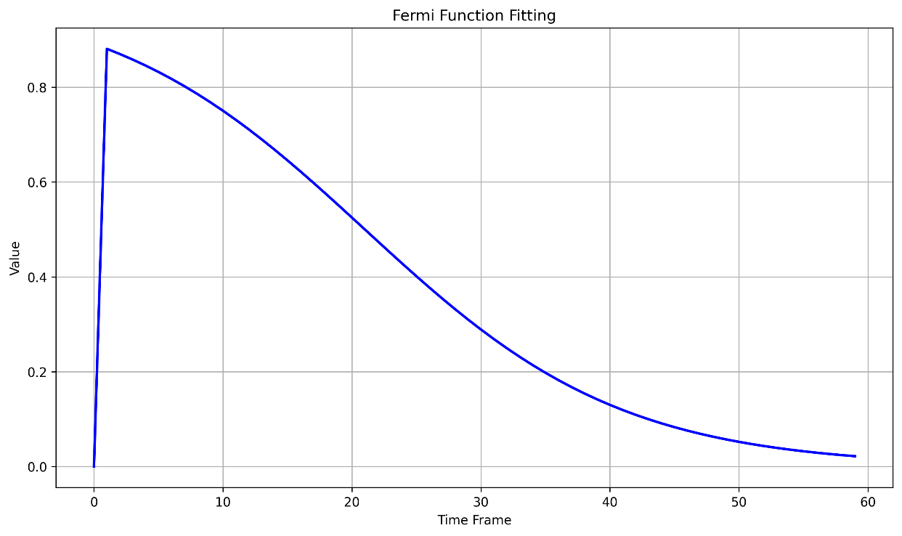
Deconvolution approach using Fermi constraint fitting
*
=
Approximate a fermi function with an initial guess (tau_0, F, k)
Do the convolution step
Find the result curve (MYO)
Repeat this process until the error being minimum
The optimized F values is MBF

Slide 11
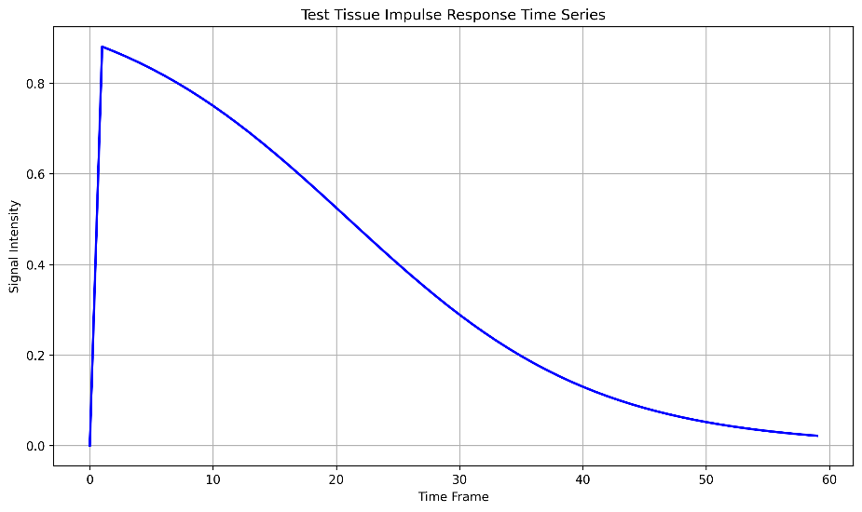
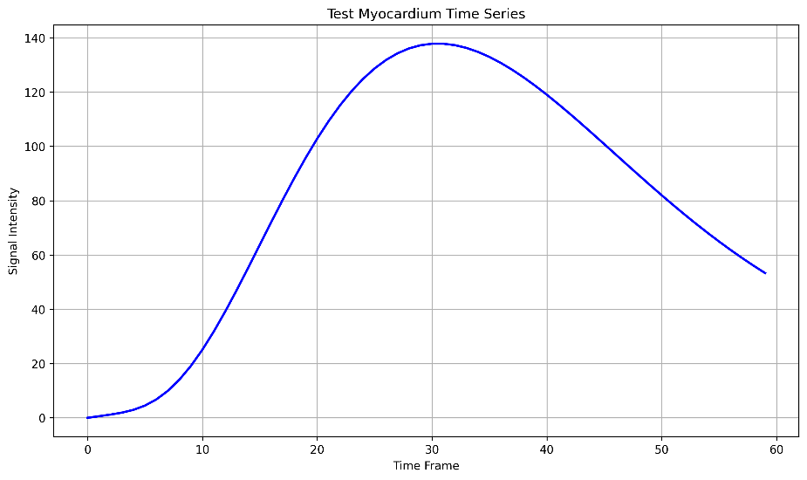
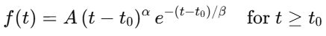
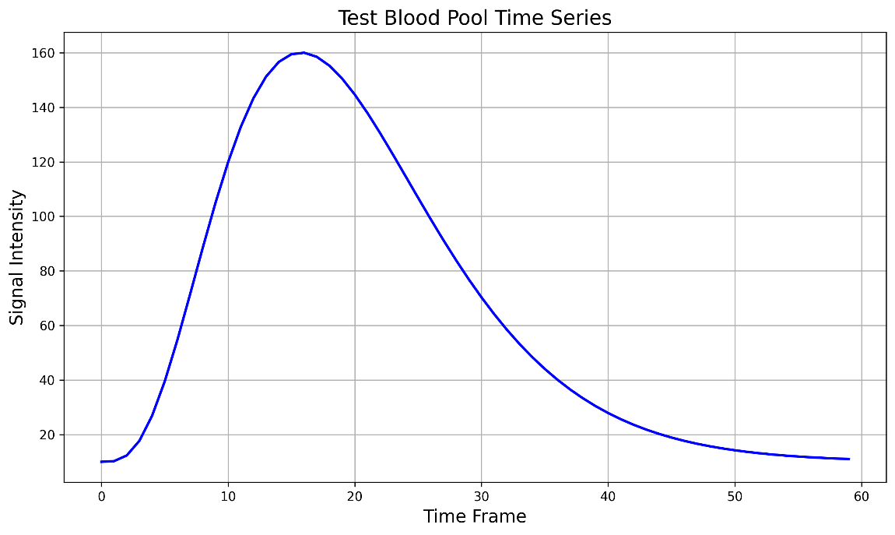
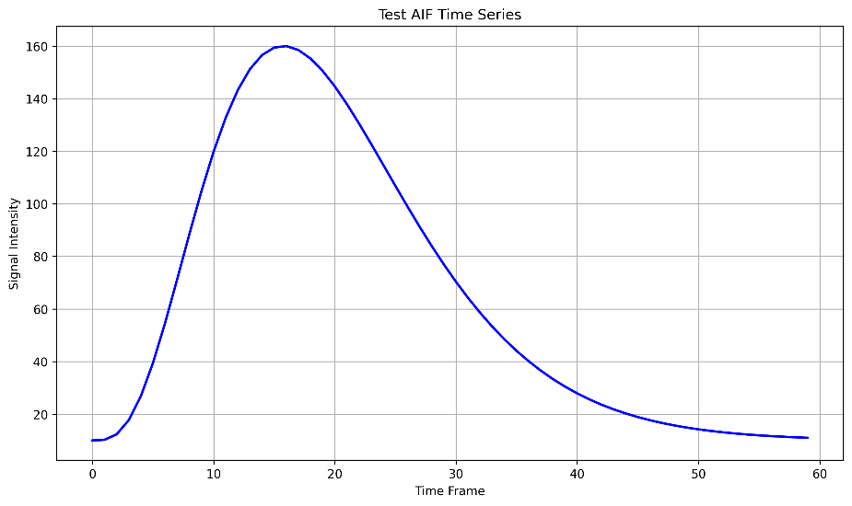
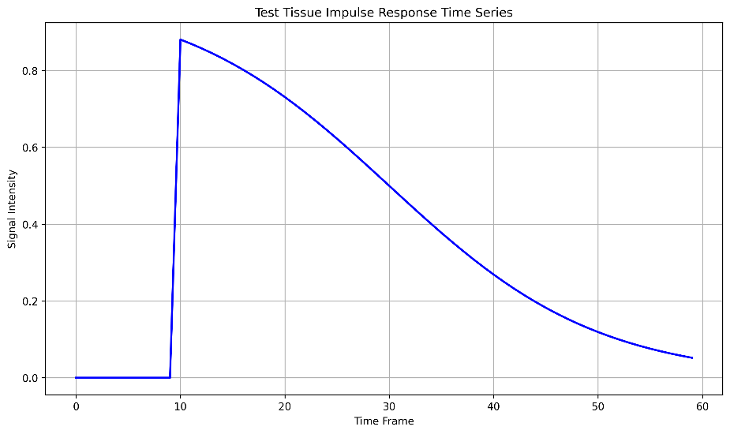
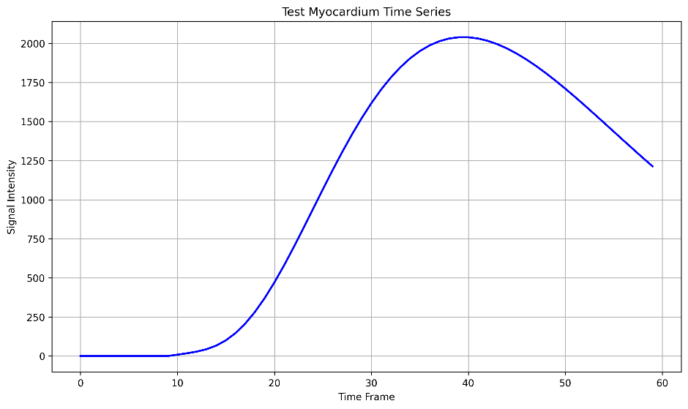
How to create synthetic data to do the verification
A gamma variate function to simulate blood pool SI:

Slide 12
Developing a series of images with only two pixels:
DICOM Image
Blood pool pixel
For developing unit test
Myocardial pixel

Slide 13


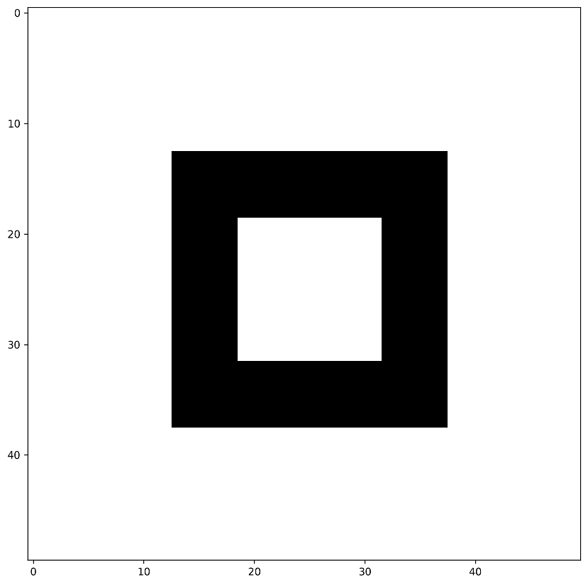
Developing a test by simplifying the geometry
Image size = (50*50) pixels
All the images (video)
Blood pool region
Myocardial region

Slide 14
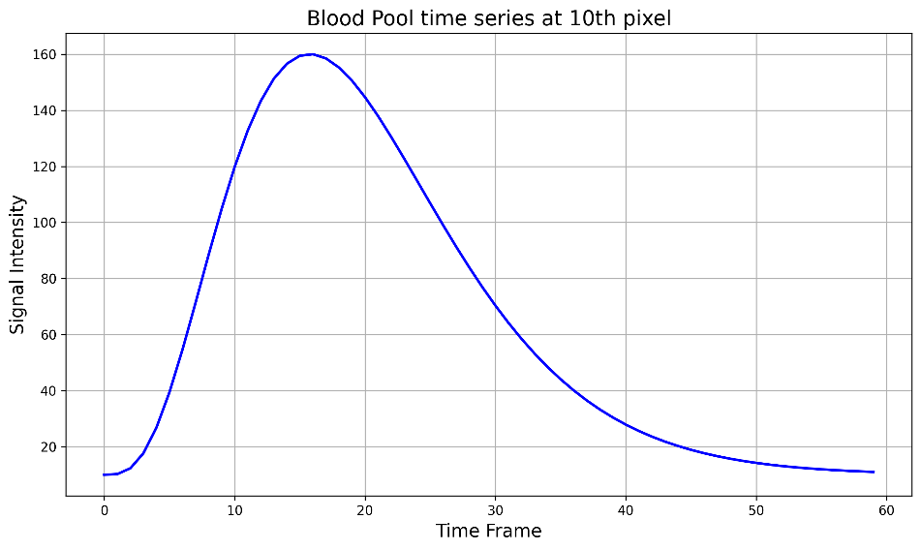
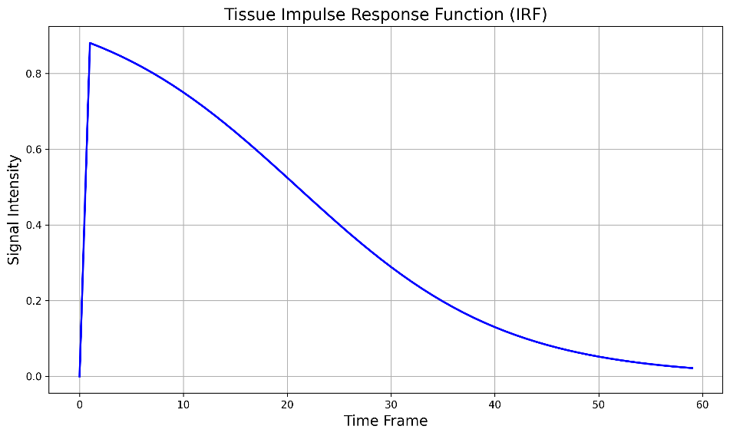
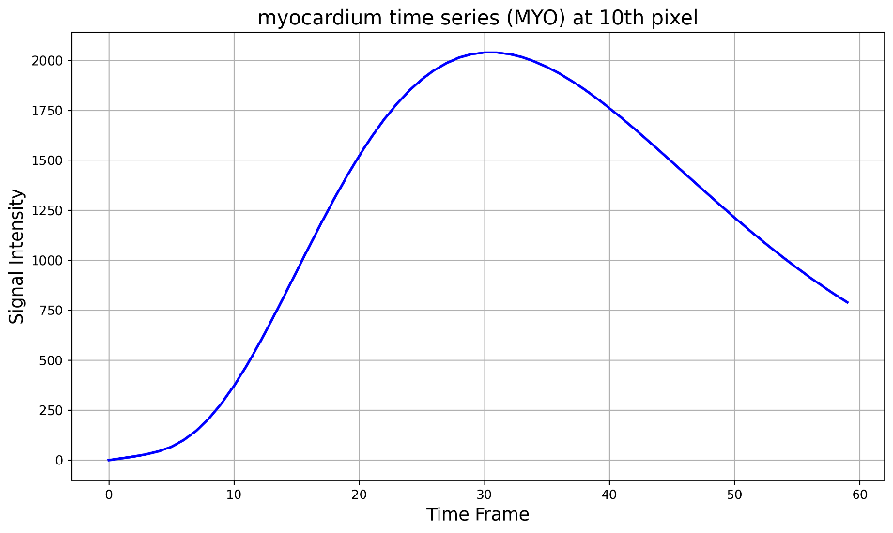
Developing a test by simplifying the geometry
Fermi function parameters:
F=1
Ƭ0=20
k=0.1

Slide 15
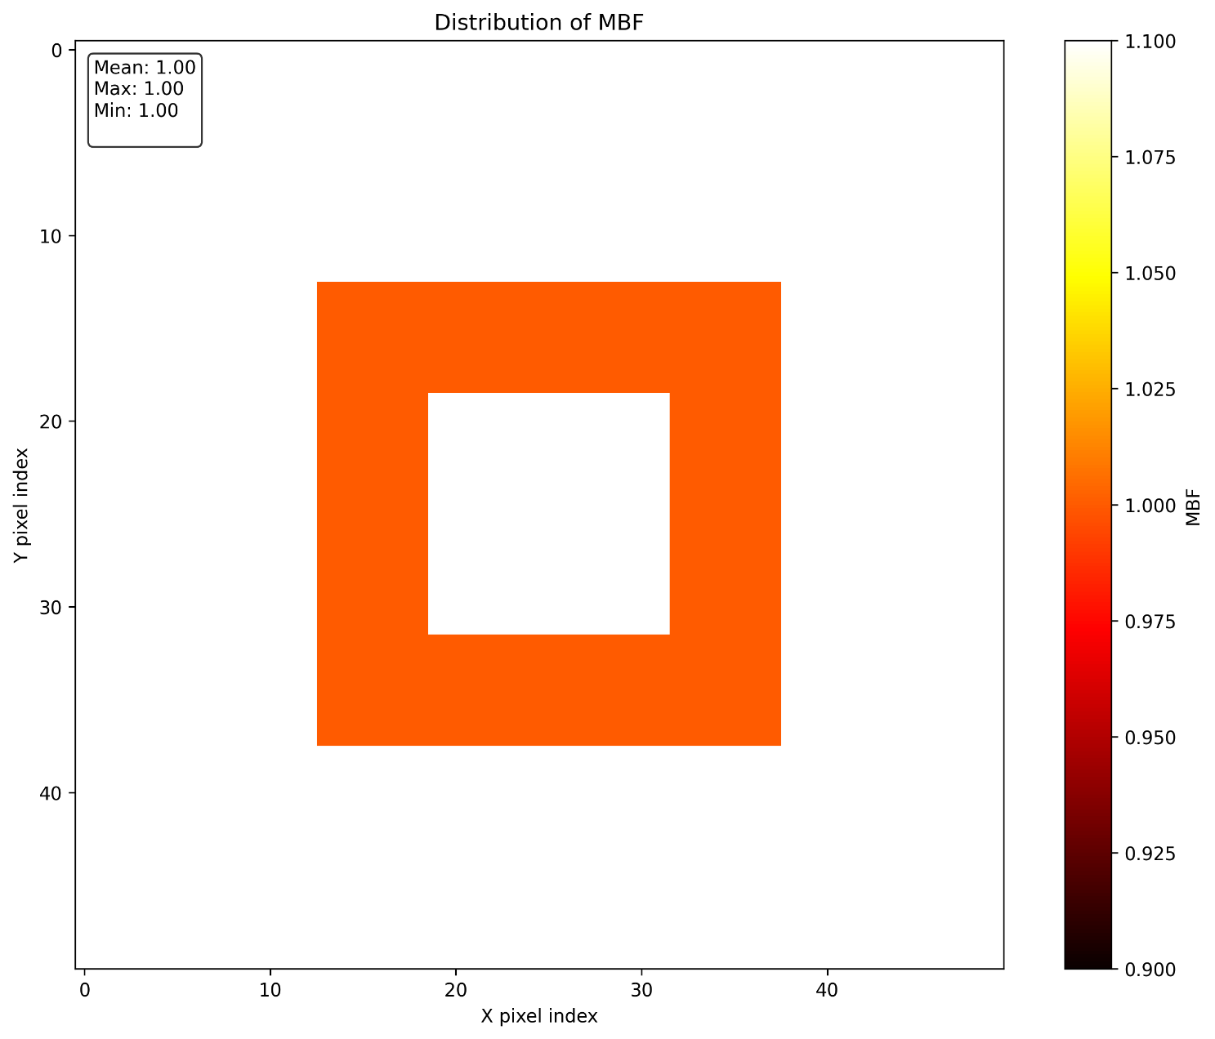
The result for the simplified geometry
As we set the value of F=1.0 in the fermi function to generate the impulse tissue response, the results is correct.

Slide 16
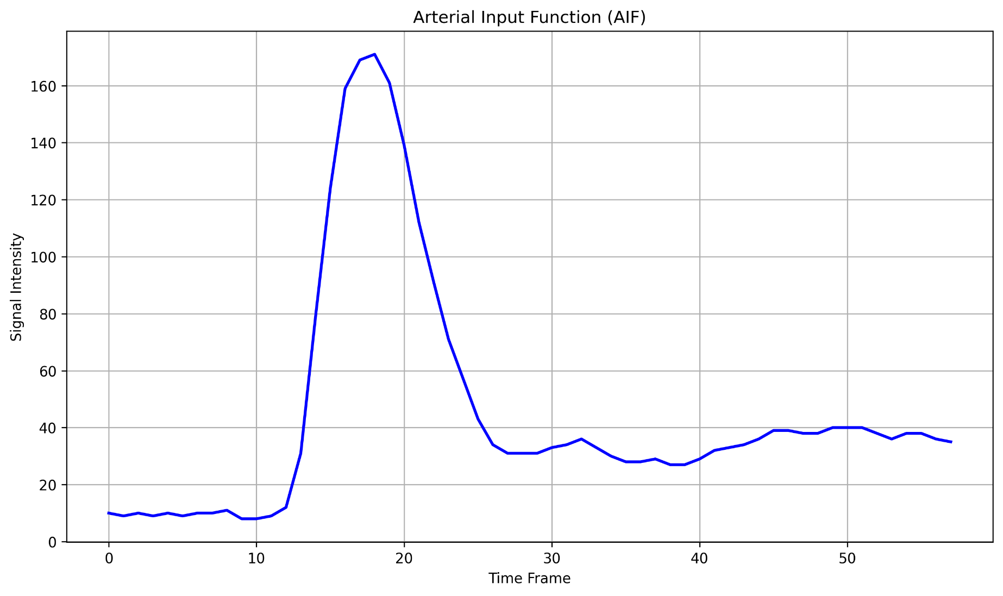
Arterial Input Function (AIF)
Performing an averaging on the blood pool region over time
It is done in compute_quantity.py in method arterial_input_function
Item 4 of section D of 1998 paper:
The signal time course in the LV blood pool can be used as an input function, cin(t), for deconvolution of the tissue curves, as previously validated in PET studies

Slide 17
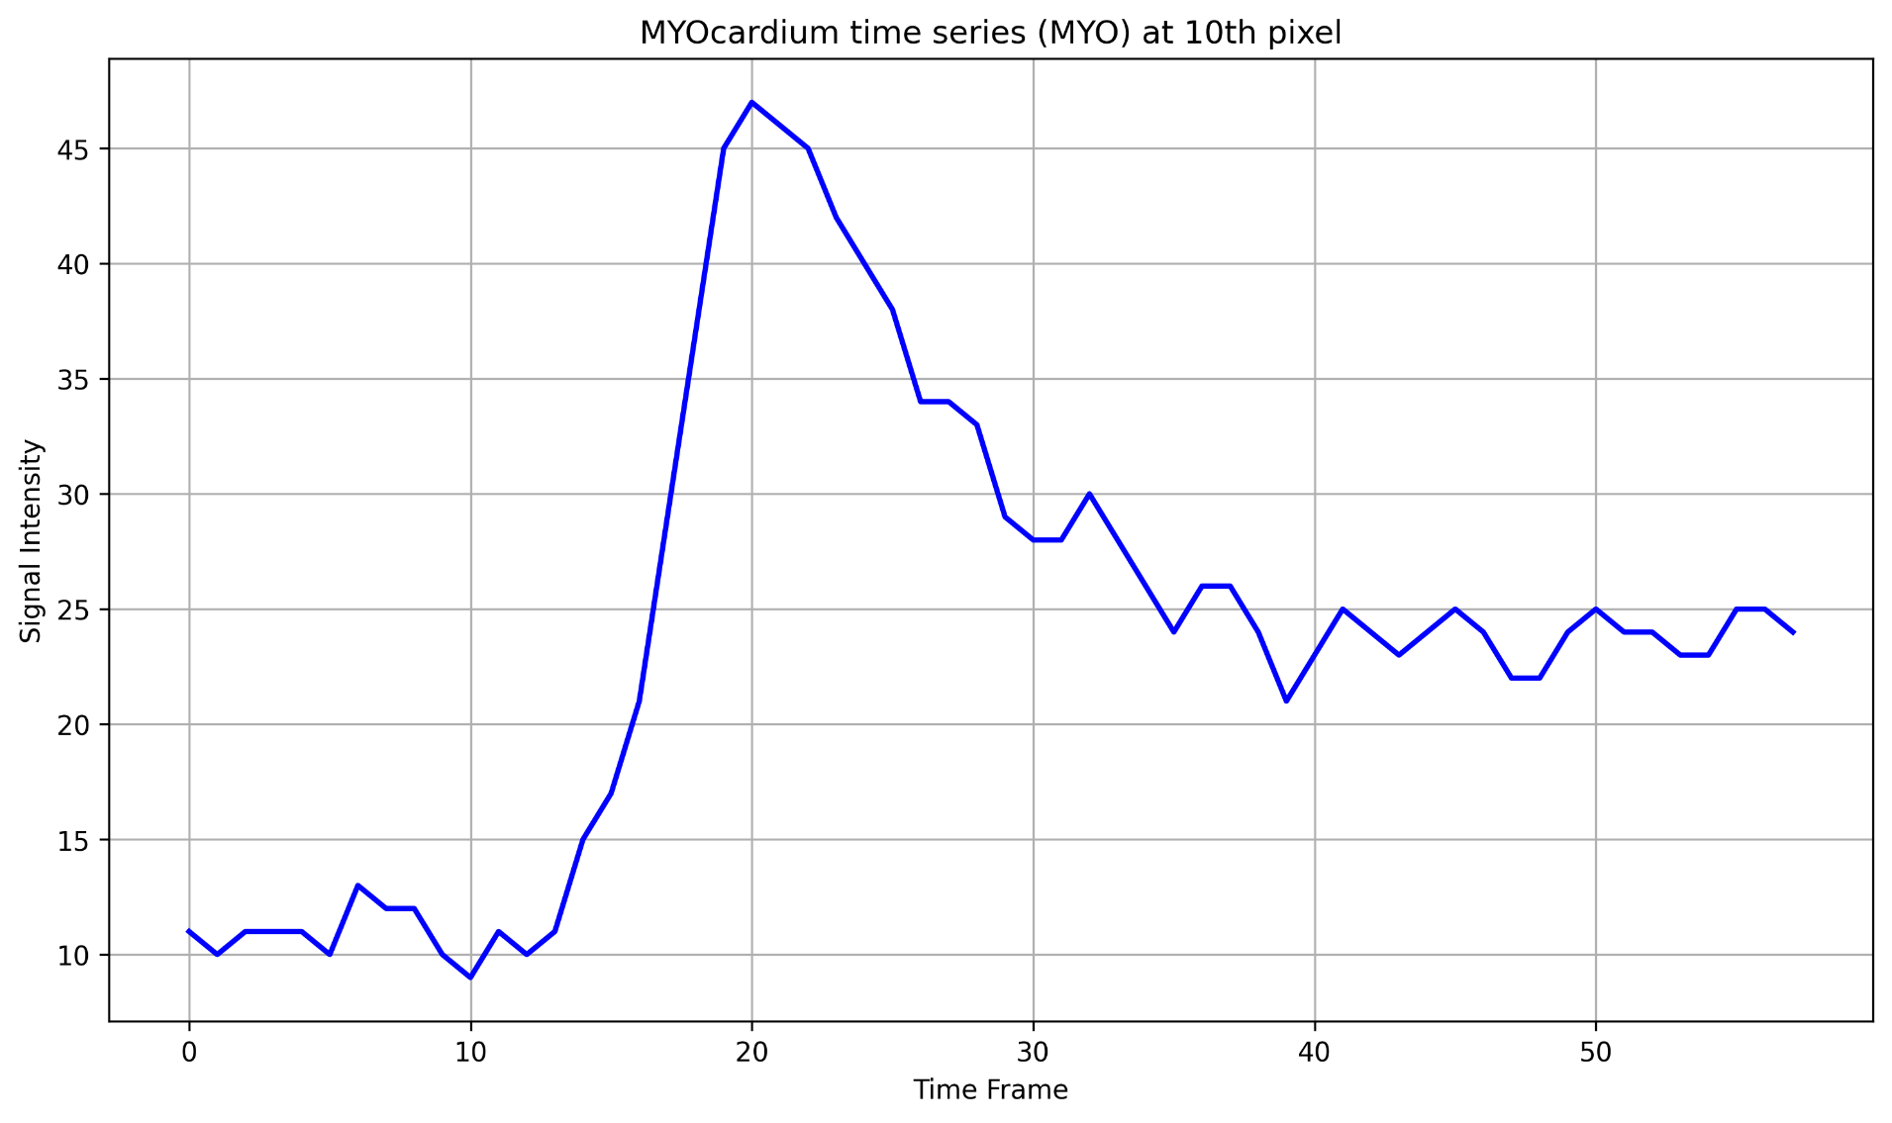
Signal intensity in myocardium region
MYO(t): Signal intensities for a pixel in the myocardium region for every pixel over time
It is done in compute_quantity.py in method myocardium_time_series

Slide 18
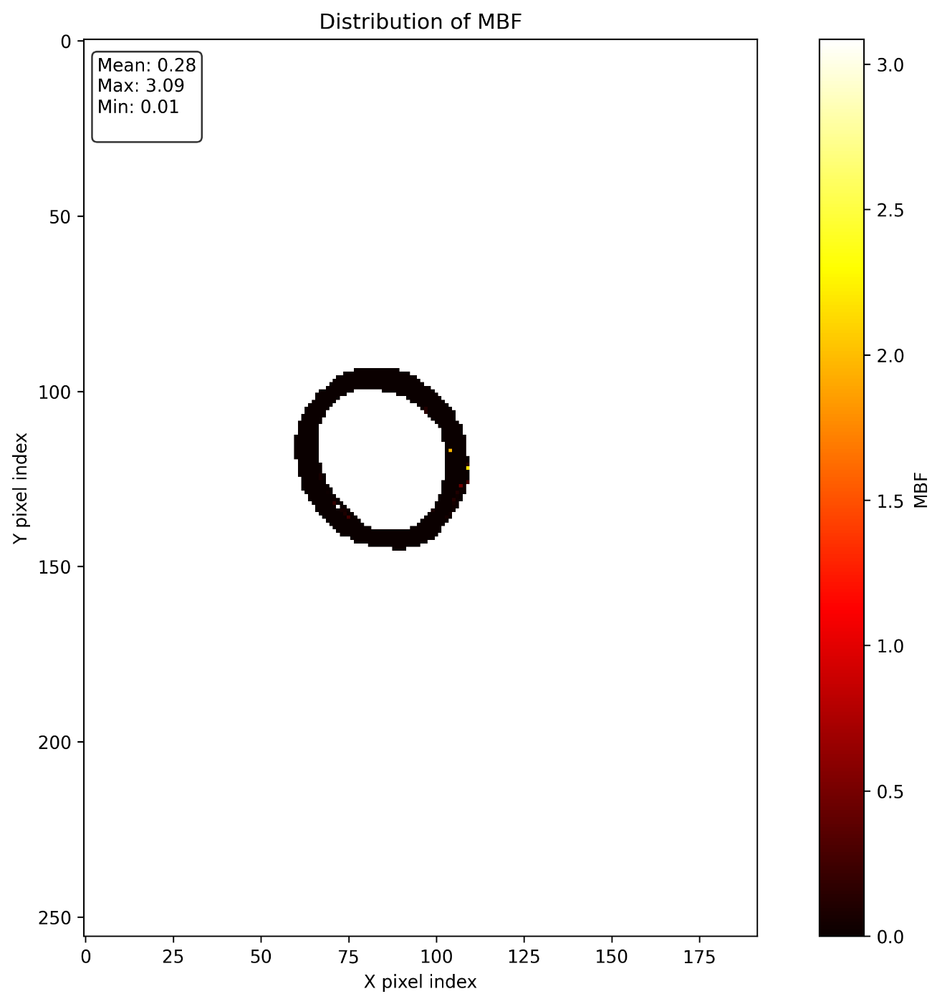
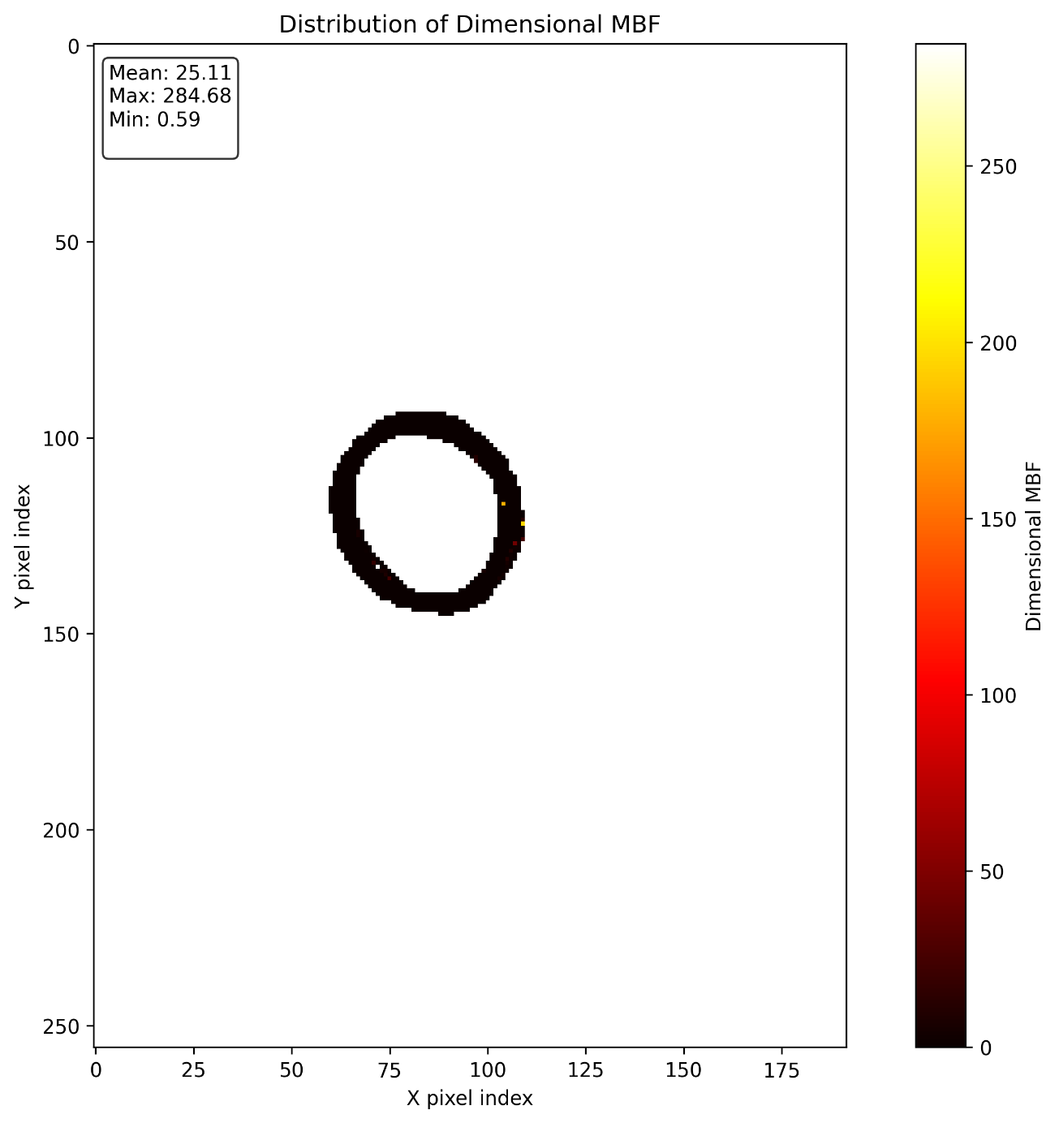
The results for the given geometry

Slide 19
Development of the code
Python
Dokerfile and docker-compose
CI using GitHub action
Document generation using Sphinx
Pytest for developing tests
Codecov to visualize test coverage
High level of documents in Readme file
All the presented figure could be regenerated by executing the tests
C++ version is under development

Slide 20
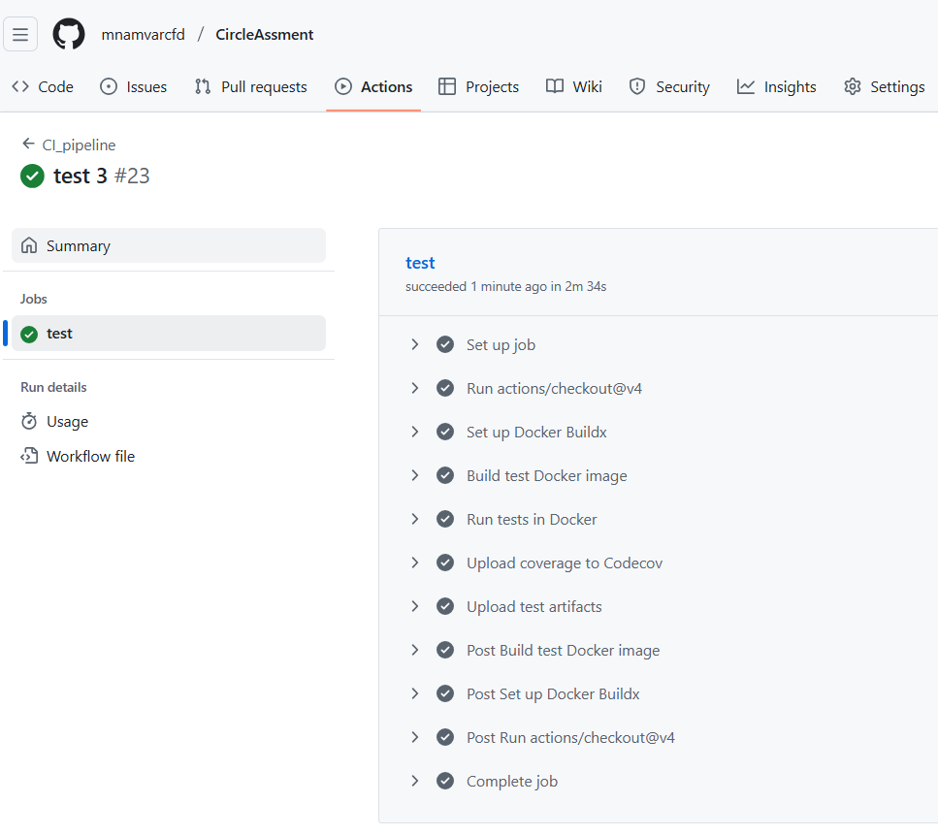
Development of the code

Slide 21
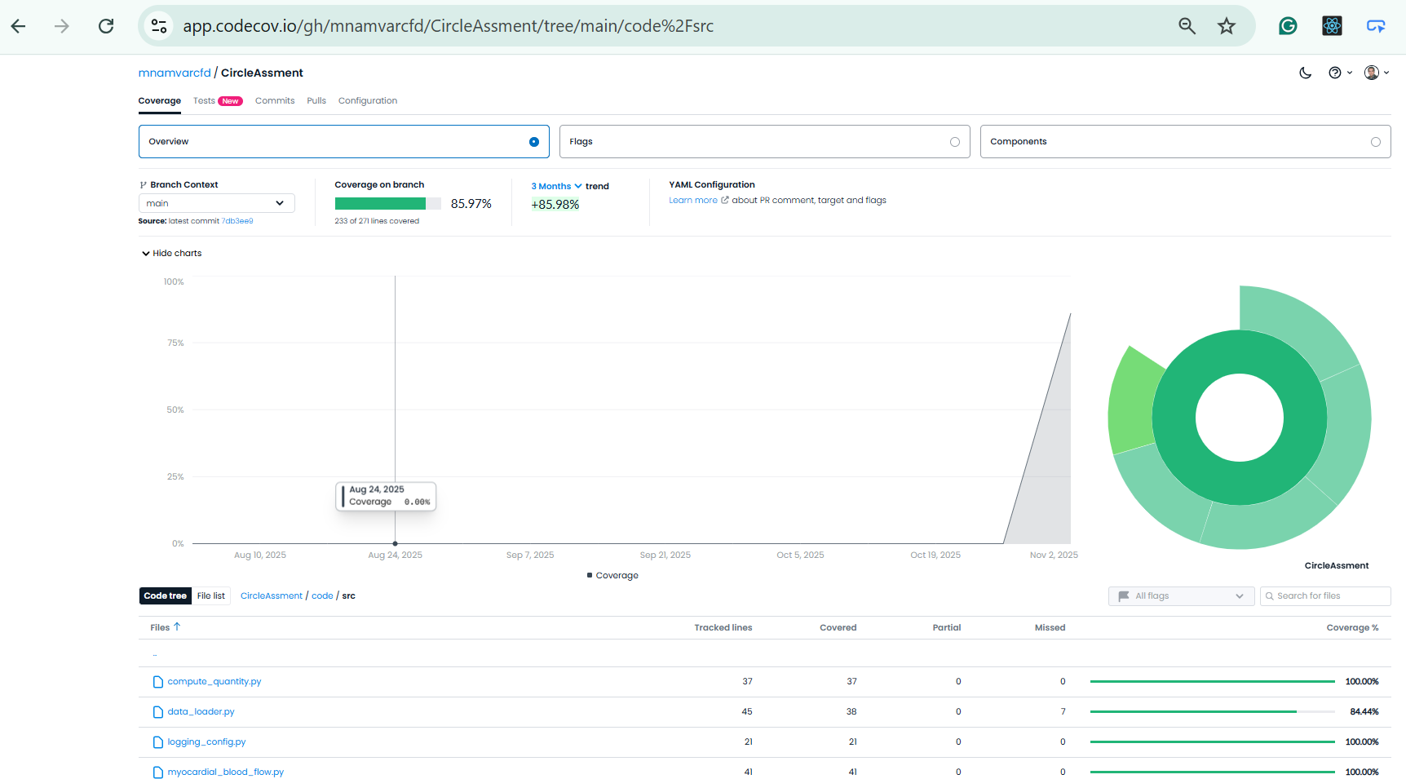
Development of the code

Slide 22
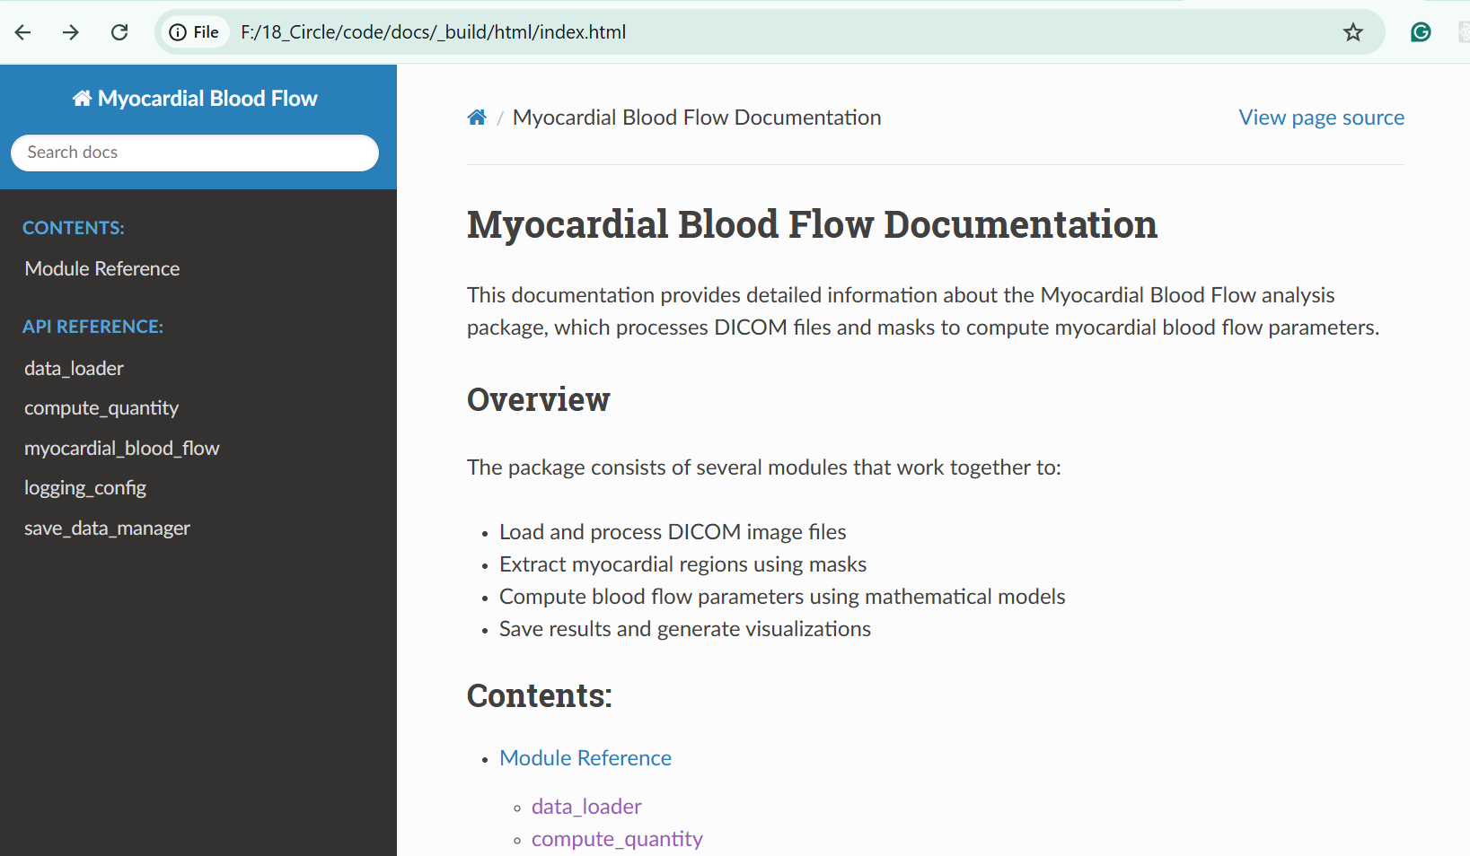
Development of the code

Slide 23
Questions?

Slide 24
The Pathway of Blood Flow Through the Heart, Animation.

Slide 25
The Pathway of Blood Flow Through the Heart, Animation.

Slide 26
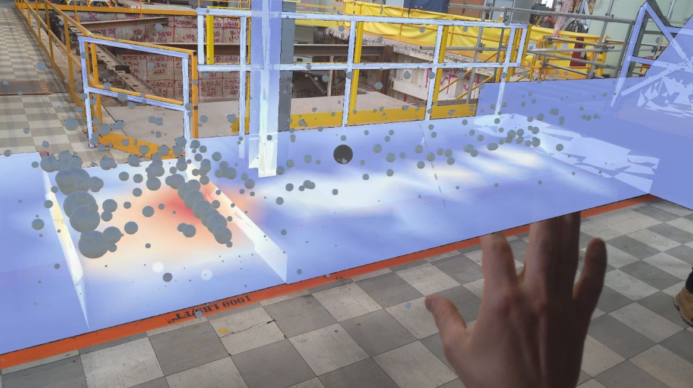
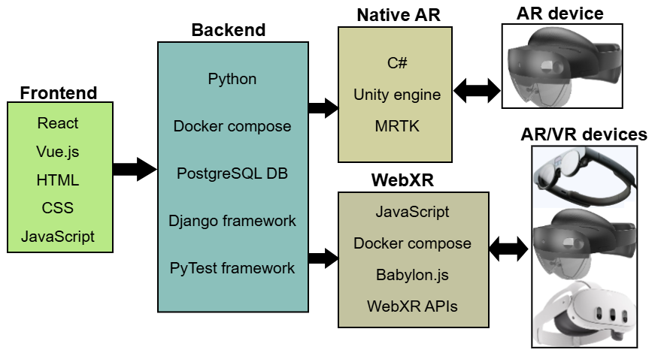
Second Postdoc: 2023-Present
Radiation field visualization in nuclear facilities using AR and VR technologies

Slide 27
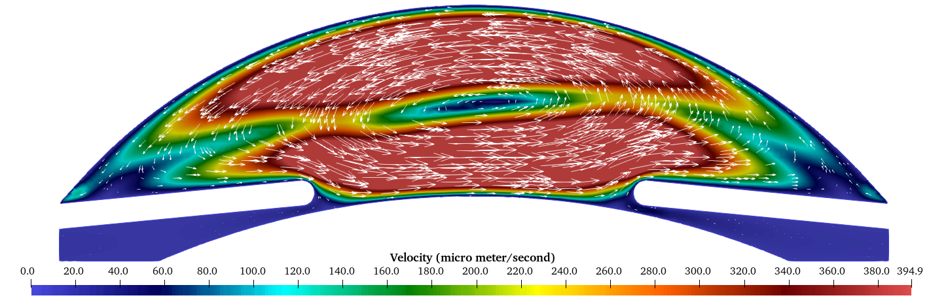
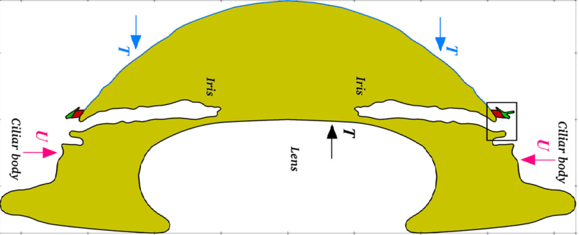
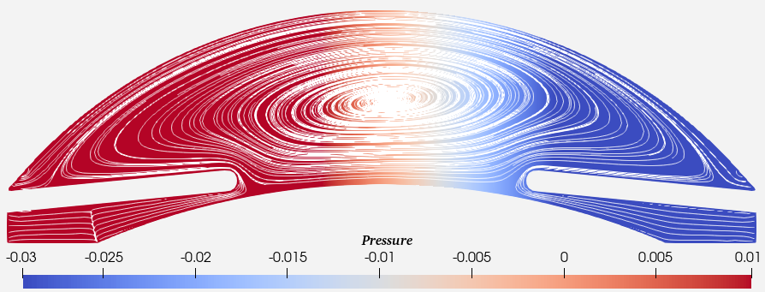
First Postdoc: 2022-2023
Modeling tritium movement through human eye lens in computational framework.

Slide 28
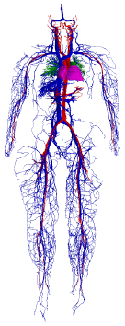
Ph.D. project
An algorithm for the lattice Boltzmann method adapted to sparse geometries and distributed memory systems
Fluid flow simulation software
Developed C++ code
Worked on super computers
Modified an algorithm
Developed 2 algorithms along with implementation in C++
To simulate the full human vessels, around 1.6 billion nodes are required

Slide 29
Working period in Iran
C++/Python
Scientific computation software
Fluid flow simulation software
Geometry optimization
Parallel programming using MPI, OpenMP, CUDA
About 100,000 lines

Slide 30
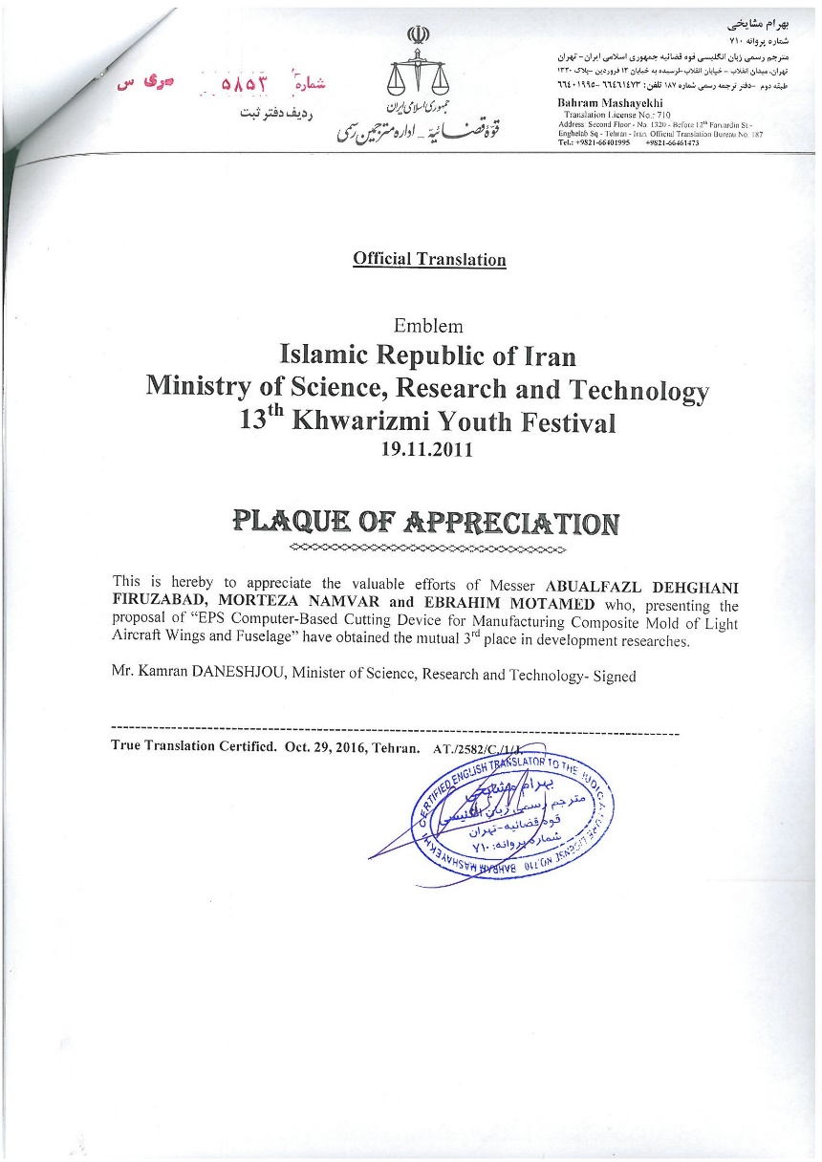
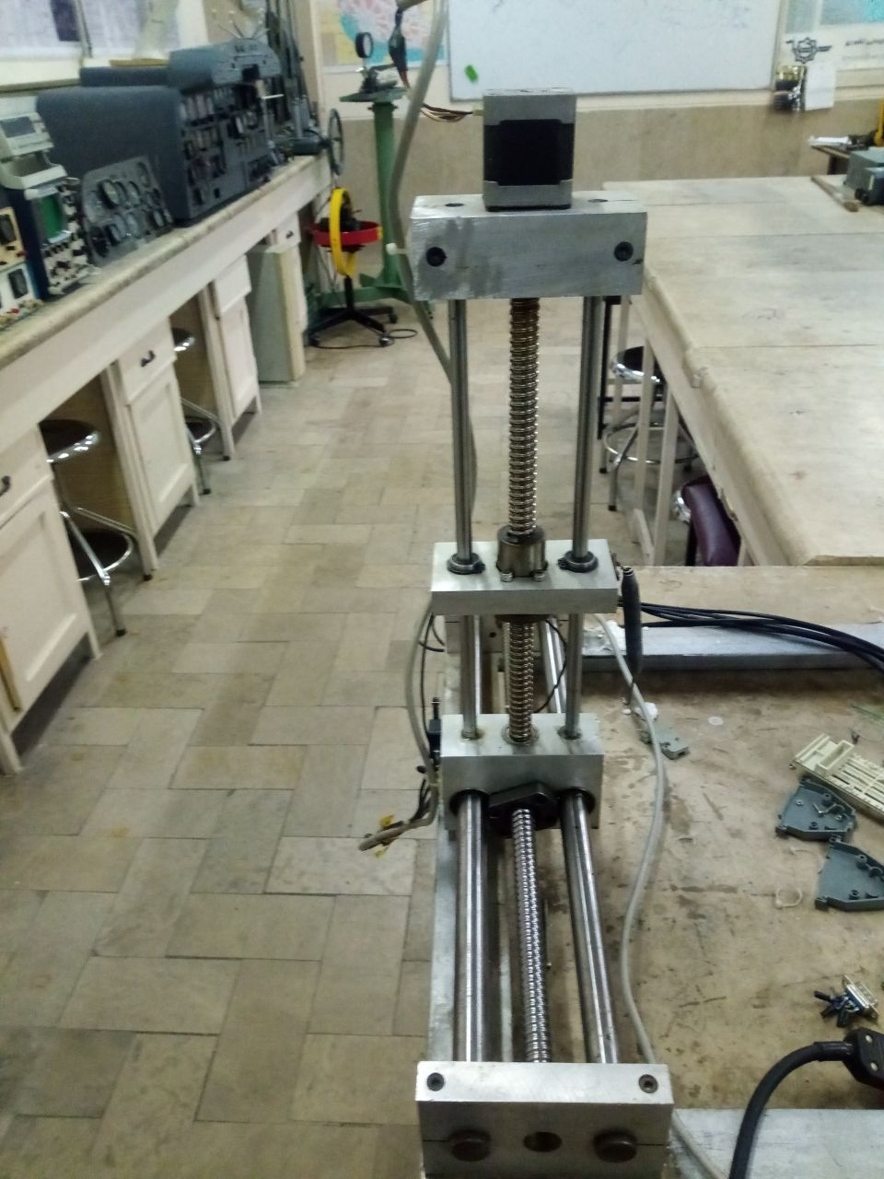
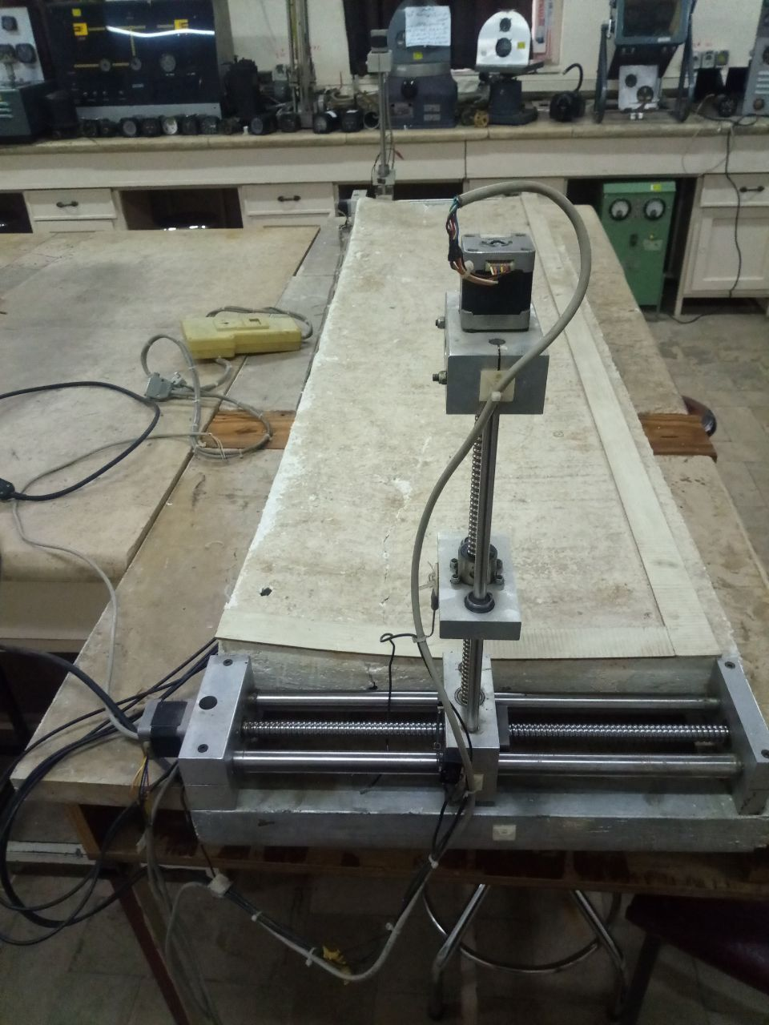
My invention:

Slide 31
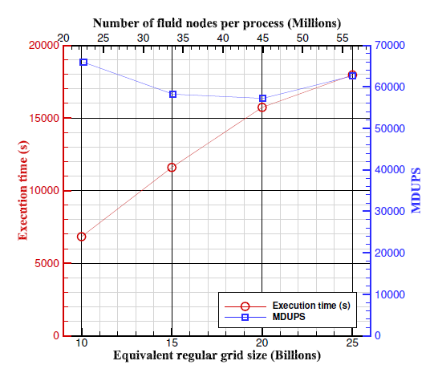
The biggest problem I solved by the developed code:

Slide 32
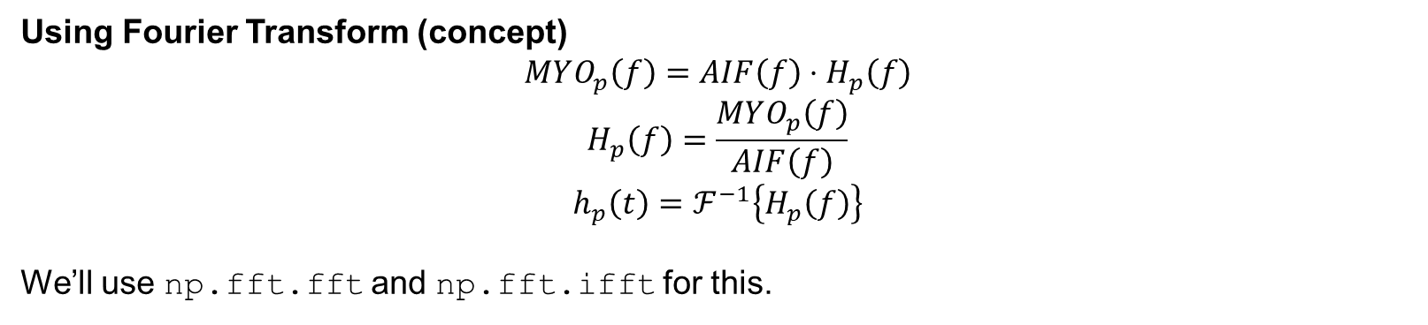

The Pathway of Blood Flow Through the Heart, Animation.
In the context of perfusion MRI (like in Quinaglia et al., 2019), you have two time signals:
AIF(t) → arterial input function (how contrast agent enters the blood)
MYO(t) → myocardial tissue signal (how contrast appears in heart tissue)
These two are related through a convolution:
$$MYO\left(t\right)=AIF\left(t\right)∗h\left(t\right)$$
where “$∗$” means convolution, and h(t) is called the tissue impulse response function.
To find $h\left(t\right)$, you need to undo the convolution, which is called deconvolution.
Using Fourier Transform (concept)
$$MYO_{p}\left(f\right)=AIF\left(f\right)⋅H_{p}\left(f\right)$$
$$H_{p}\left(f\right)=\frac{MYO_{p}\left(f\right)}{AIF\left(f\right)}$$
$$h_{p}\left(t\right)=ℱ^{−1}\left\{H_{p}\left(f\right)\right\}$$
We’ll use np.fft.fft and np.fft.ifft for this.

